Slide 1
M5

Slide 2

Levels of cause of a disease
Why is the baby
not healthy?

Slide 3
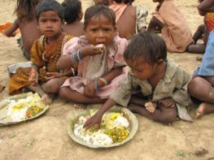
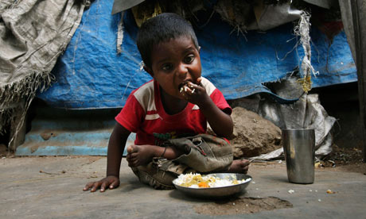
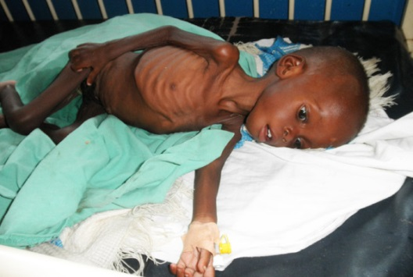
Levels of cause of a disease
Perhaps because it is not well nourished and does not get enough food.
So, lack of good nourishment becomes a second level cause of the disease
Because it is from a household which is poor and the public services are also poor where the babies family lives.
So, poverty or lack of public services become third-level causes of the baby’s disease.
Why is the baby not well nourished?

Slide 4
Types of disease :
Disease can be broadly classified in two different ways :
1. Based on the time for which the disease lasts and
2. Based on the cause of the disease
Let us see the first one

Slide 5
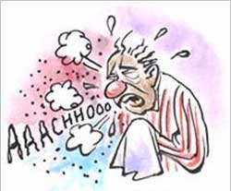
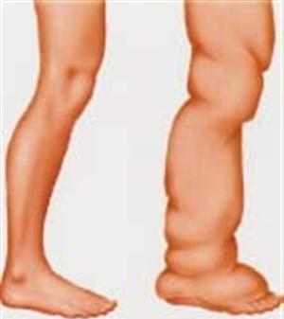
1. Based on the time for which the disease lasts :
DISEASES
are of two types
Acute disease
Chronic disease
Some diseases last for only very short periods of time, and these are called acute diseases.
E.g. Common cold lasts only a few days.
Other ailments can last for a long time, even as much as a lifetime, and are called chronic diseases.
E.g. Elephantiasis, which is very common in some parts of India.

Slide 6
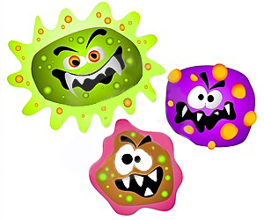


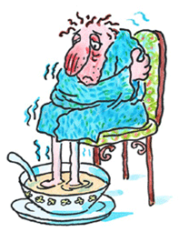
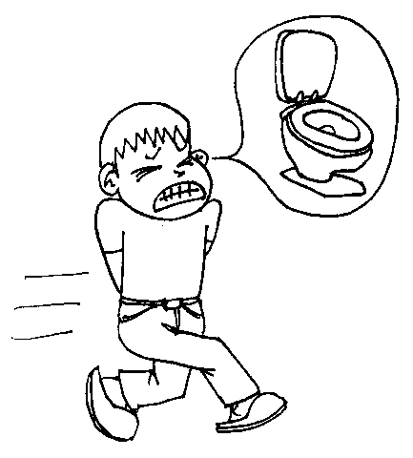
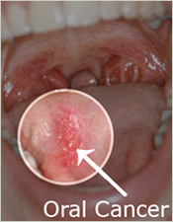
2. Based on the cause of the disease
DISEASES
are of two types
Infectious disease
Non-Infectious disease
Disease caused by infectious agents i.e. microorganisms.
They spread from one person to another.
E.g. Influenza, Amoebic dysentry etc.
They are not caused by infectious agents i.e. microorganisms.
It is caused due to internal non-infectious reasons.
E.g. Cancer, High blood pressure etc.

Slide 7
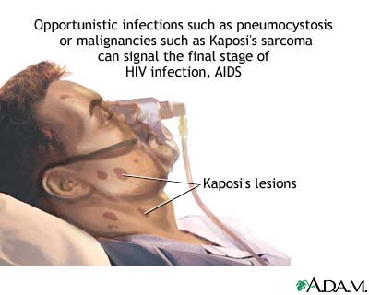
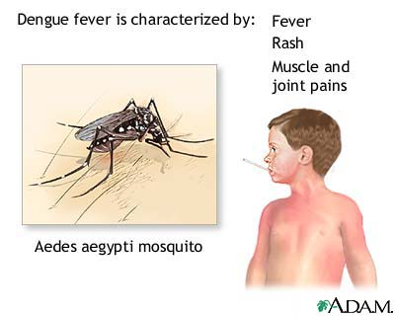
Infectious diseases
Disease caused by infectious agents.
Infectious Agents :
Organisms that can cause diseases are of different categories.
1.
Viruses
E.g. – Common cold,
Influenza,
Dengue fever
and AIDS.

Slide 8
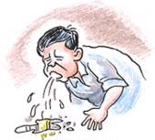
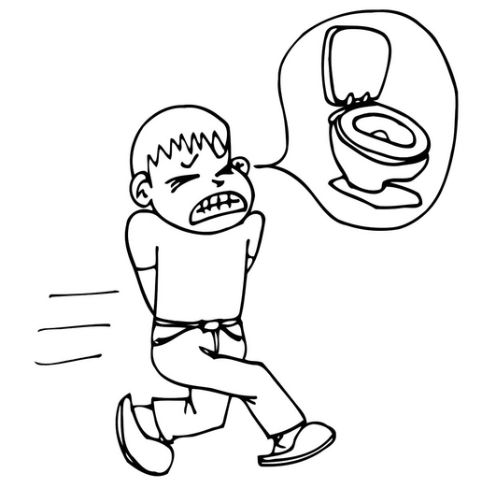
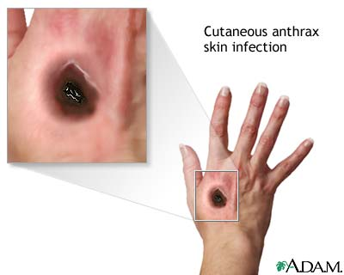
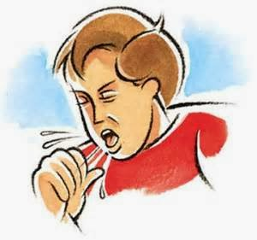
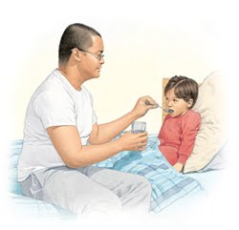
2.
Bacteria
E.g. – Typhoid fever,
Cholera,
Tuberculosis
and Anthrax.

Slide 9
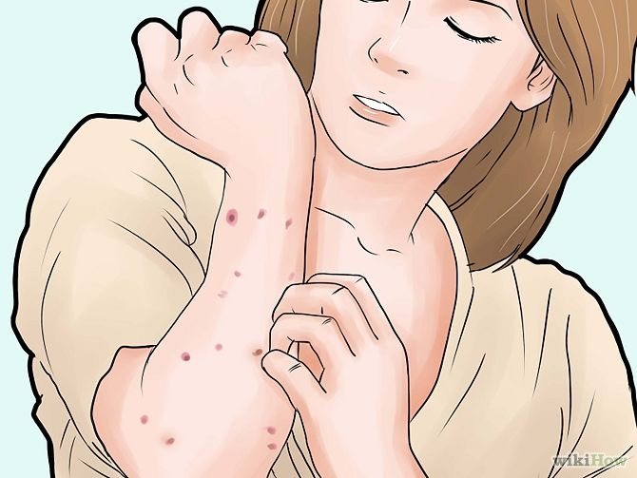
3.
Fungi
E.g. – Skin infection.

Slide 10
4.
Protozoan
E.g. – Malaria and Kala-azar

Slide 11
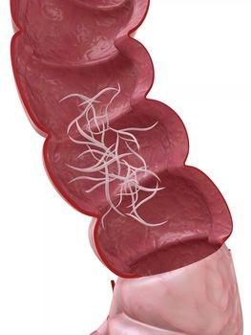
5.
Worm
E.g. – Intestinal worm infections
OR Elephantiasis

